Slide 1
Competency Evaluation System
Project Guide-Mr. Milind Arjun
Institute – Institute for advance computing and Software development
akurdi, pune
Prepared by:-
Group No:22
Akshay kumar mishra(1005)
Nikhil Inamdar(1057)
Mohd.Aamir Siddiqui(1049)
Sagar Mangulkar(1154)

Slide 2
Introduction:-
Competency Evaluation System is a system that maps the progress of employees in the organization at various sub-technology.
The system collects statistical Information about candidate evaluation through computer based test (CBT ).
Facility to maintain questions based on sub-technology and each question should have specific competency .
Every test is generated based on particular sub-technology and should have different competency weightage.
reports are generated based on test results.

Slide 3
Objective:-
To evaluate skill of candidate on the basis of standard test.
To generate valuable reports for candidate as well as for the resourcing team.
To maintain quality of test system traces feedback from the candidate.
To maintain Question bank of particular sub technology having specific competency level.

Slide 4
Module Description:-
Login and Password Management
Admin
Expert
Candidate
Report

Slide 5
Login and Password Management:-
Role based access
Authentication and Authorization for logged in user.
Password Management
Forget Password
Check for illegal penetration URL rewriting.

Slide 6
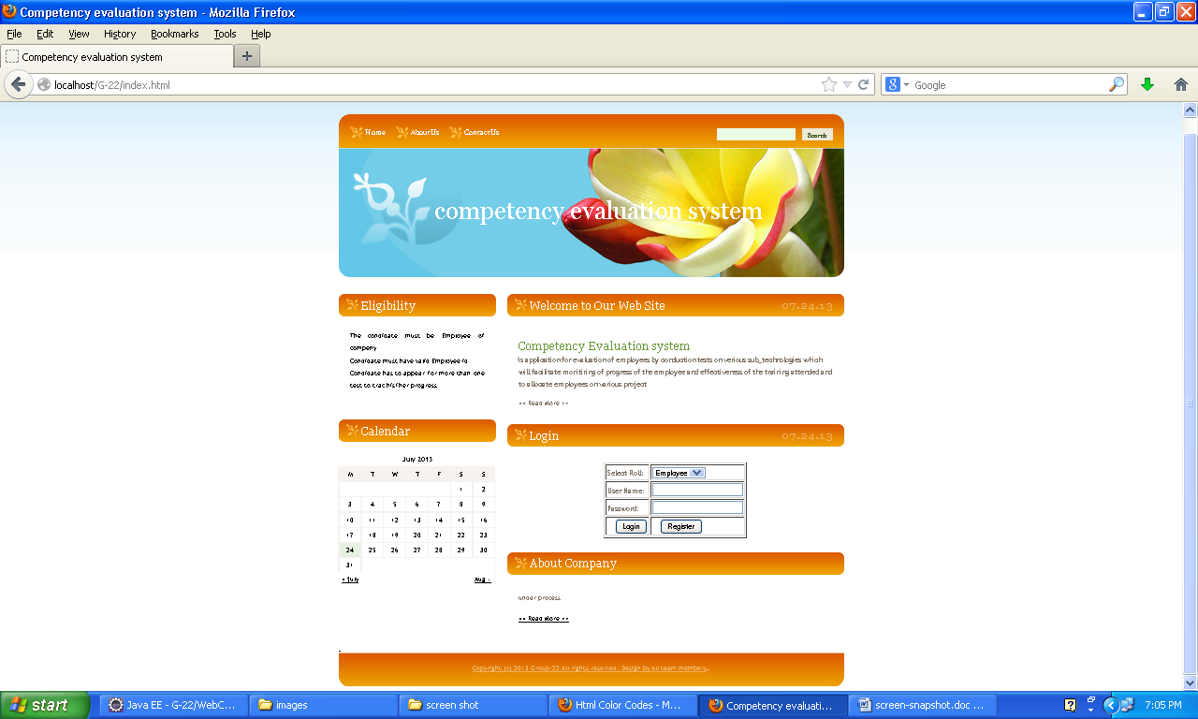

Slide 7
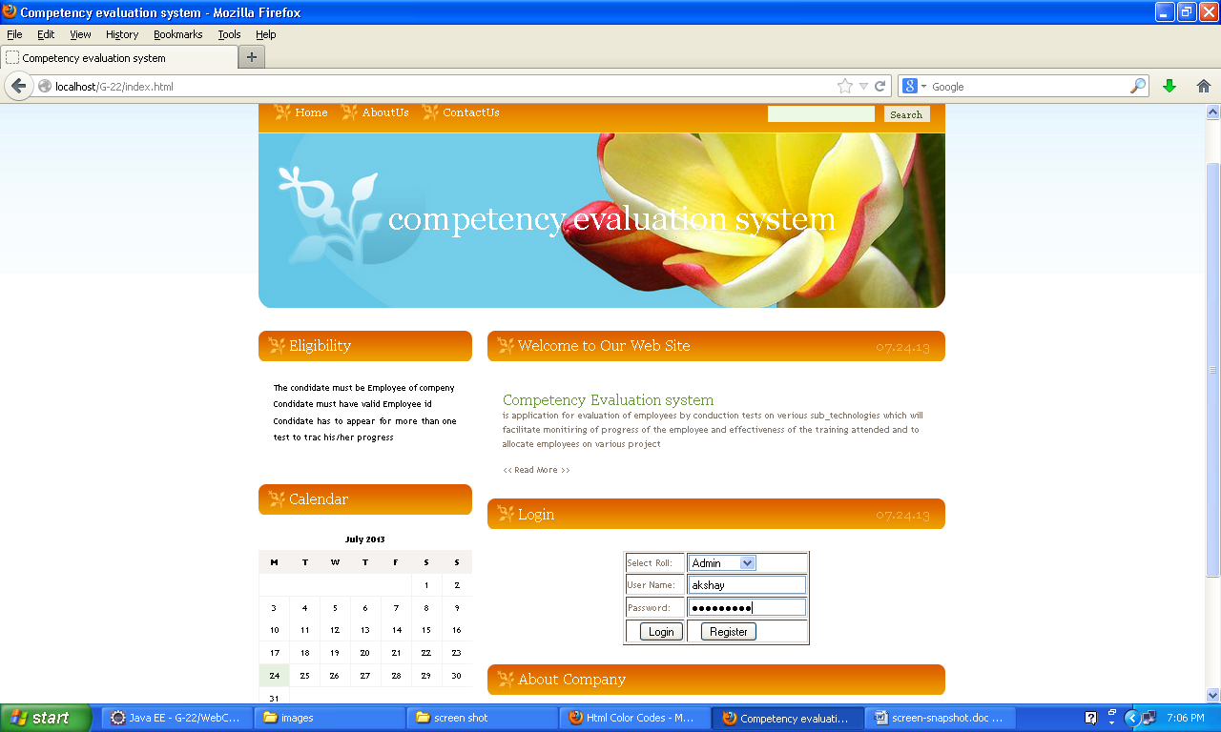

Slide 8
Admin:-
Technology management
Expert Management
Add tests
Enroll employees for tests.
Password management.

Slide 9


Slide 10
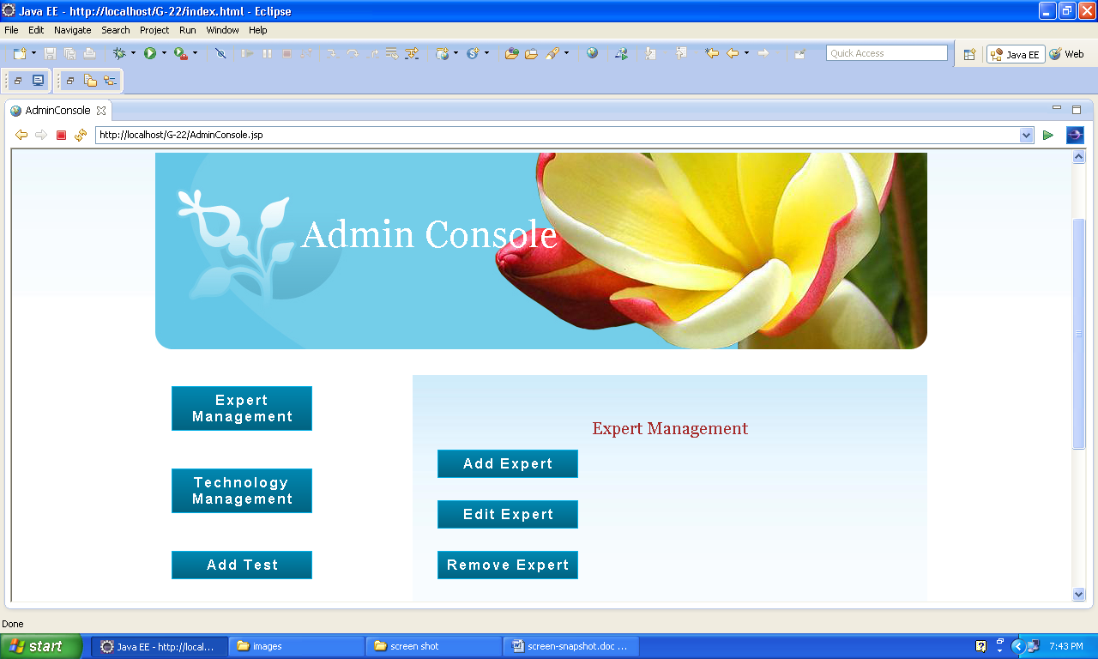

Slide 11
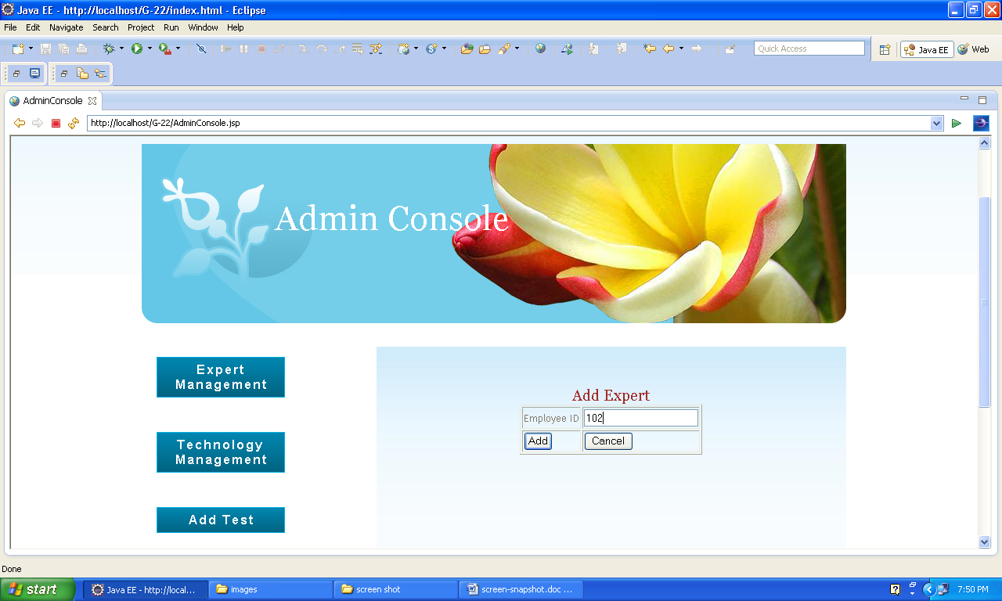

Slide 12
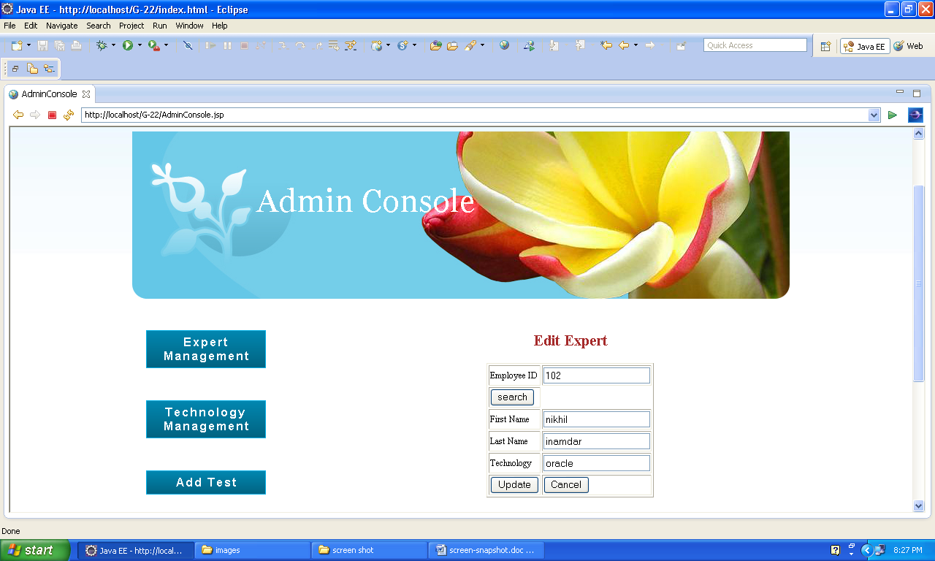

Slide 13
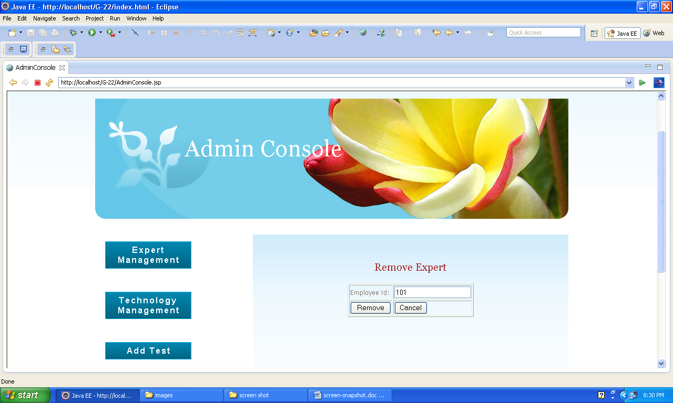

Slide 14
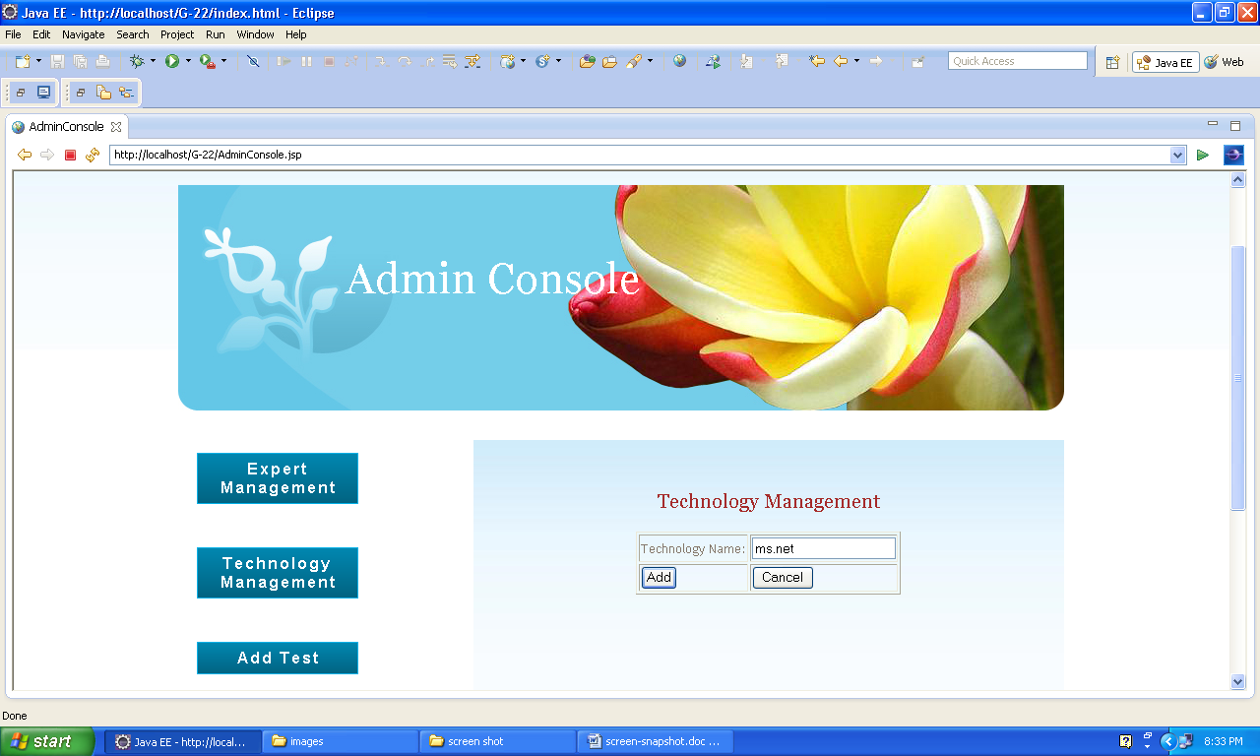

Slide 15
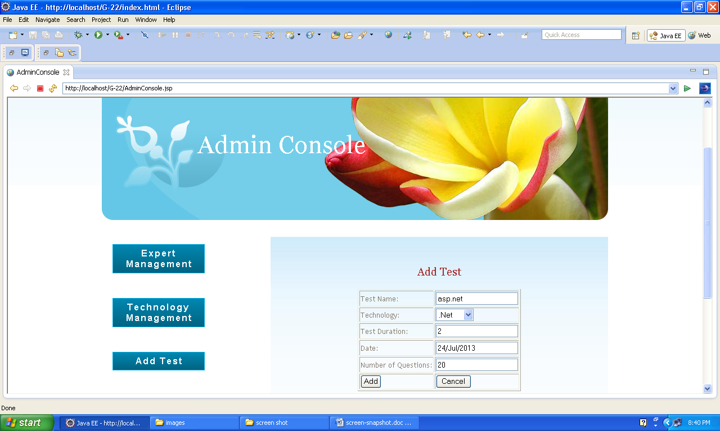

Slide 16
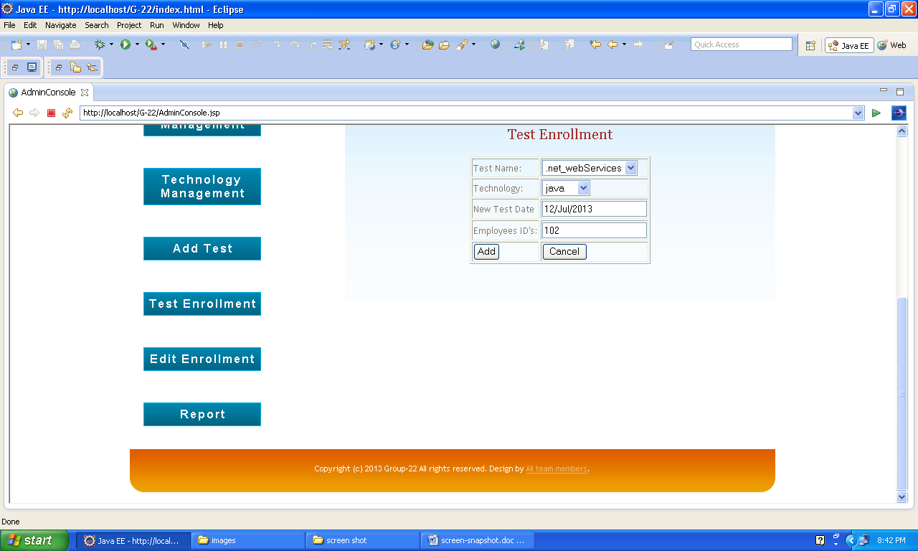

Slide 17
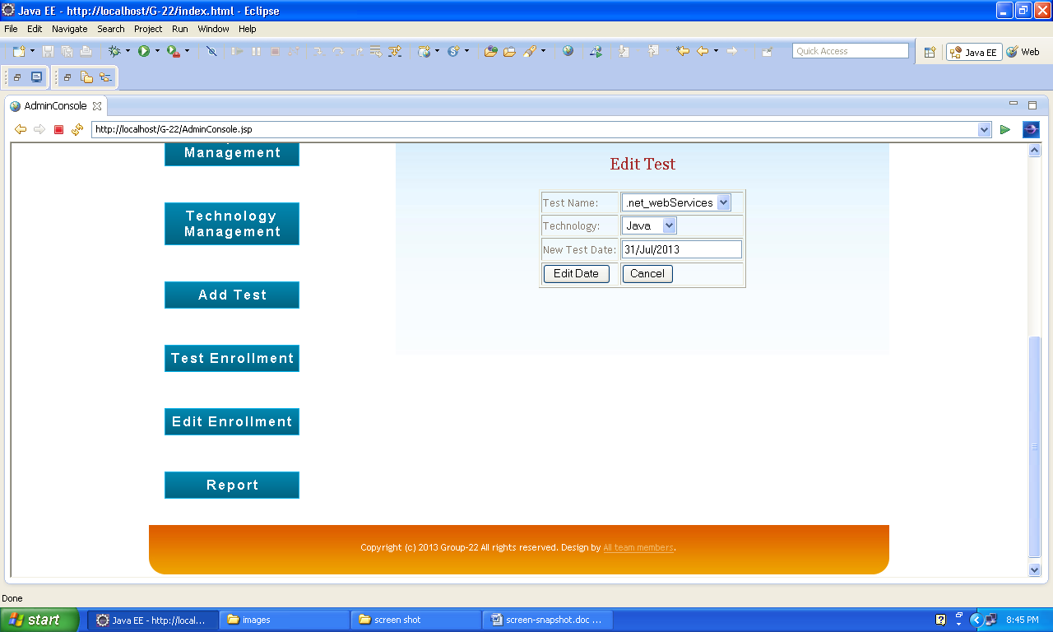

Slide 18
Expert:-
Questionnaire Management
Add Question
Edit Question
Delete Question
Profile Management
Password Management

Slide 19


Slide 20


Slide 21
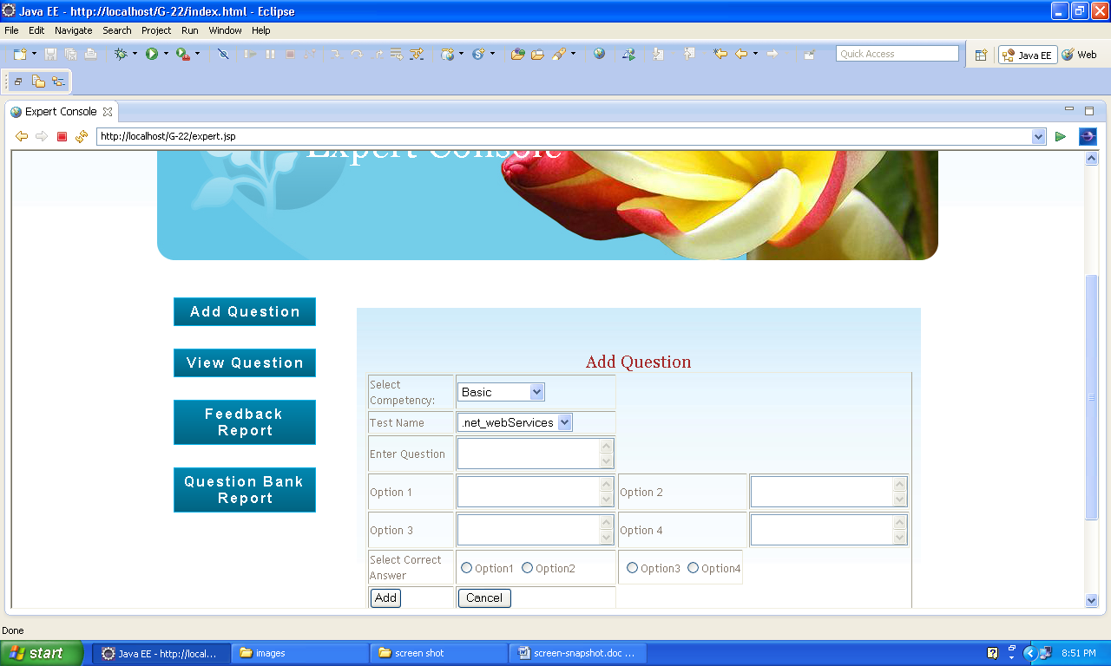

Slide 22
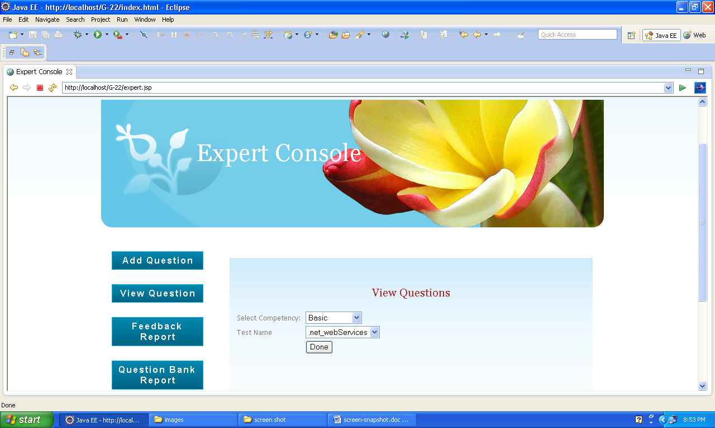

Slide 23


Slide 24
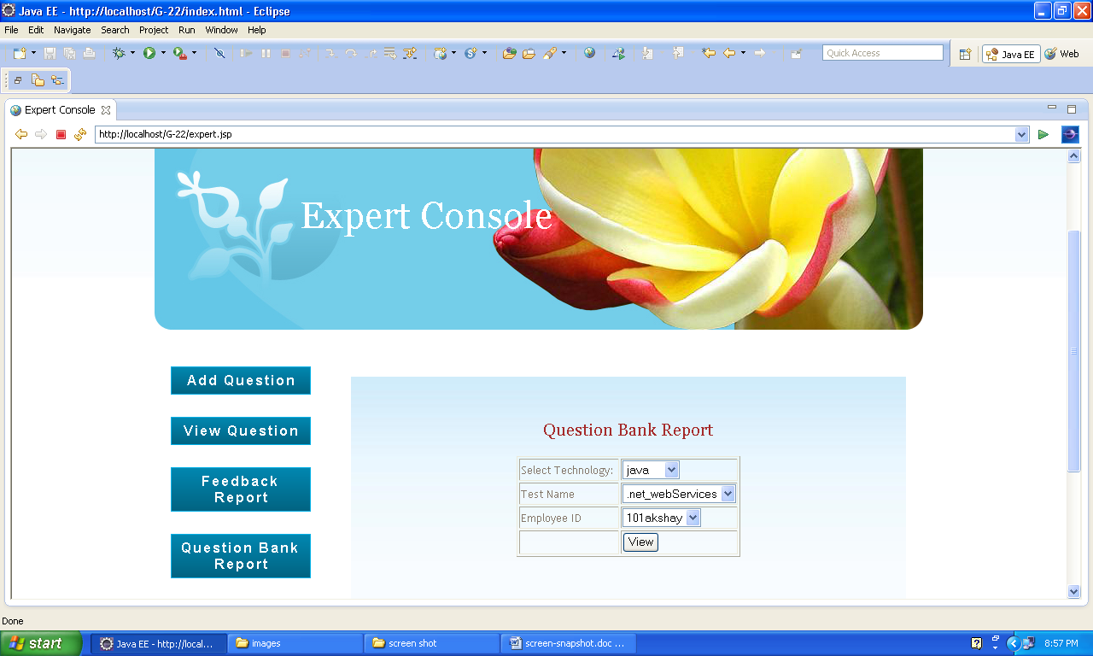

Slide 25
Employee:-
Individual Report
Profile Management
Test Improvement

Slide 26
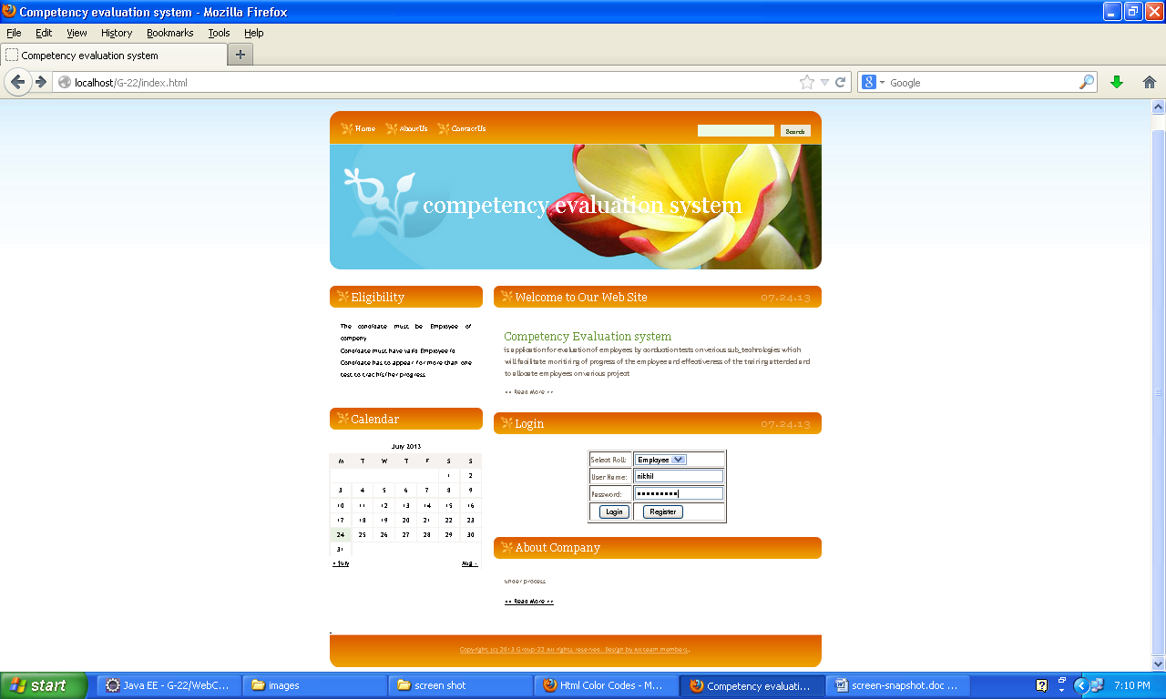

Slide 27
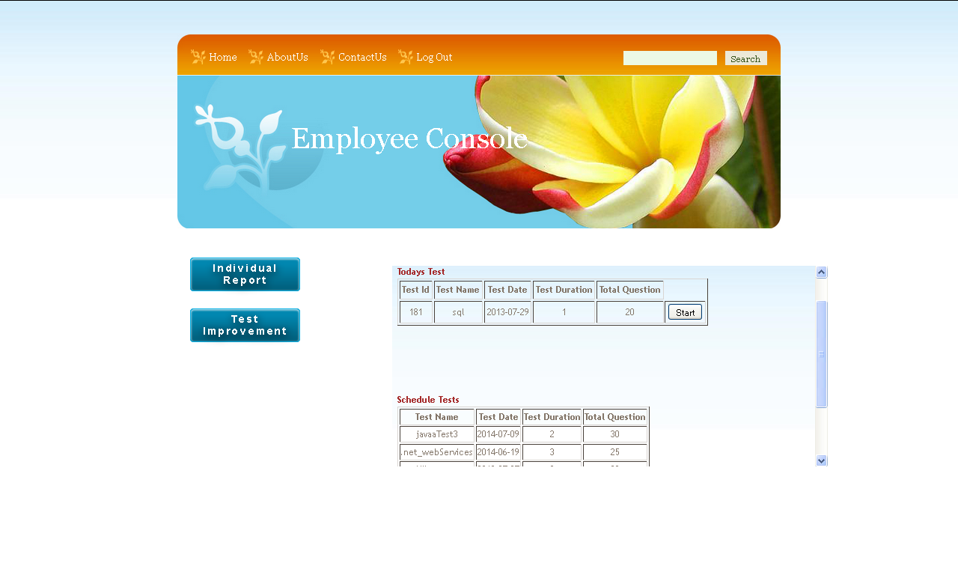

Slide 28


Slide 29
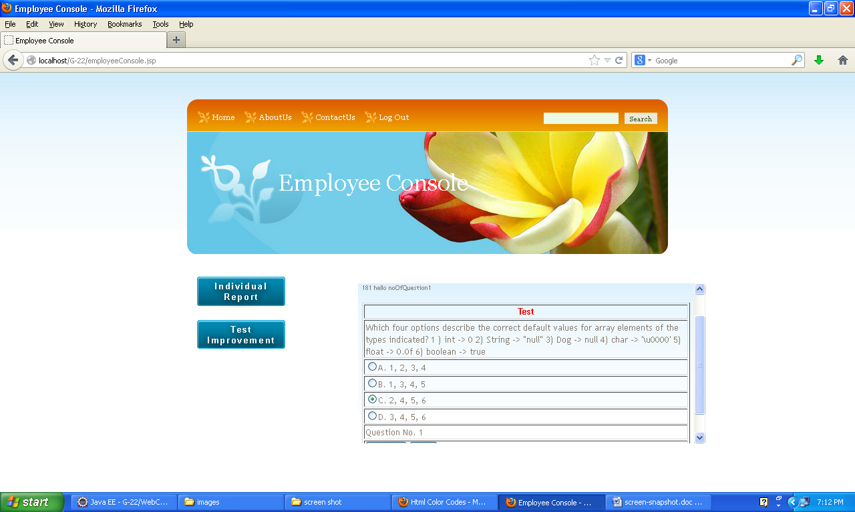

Slide 30
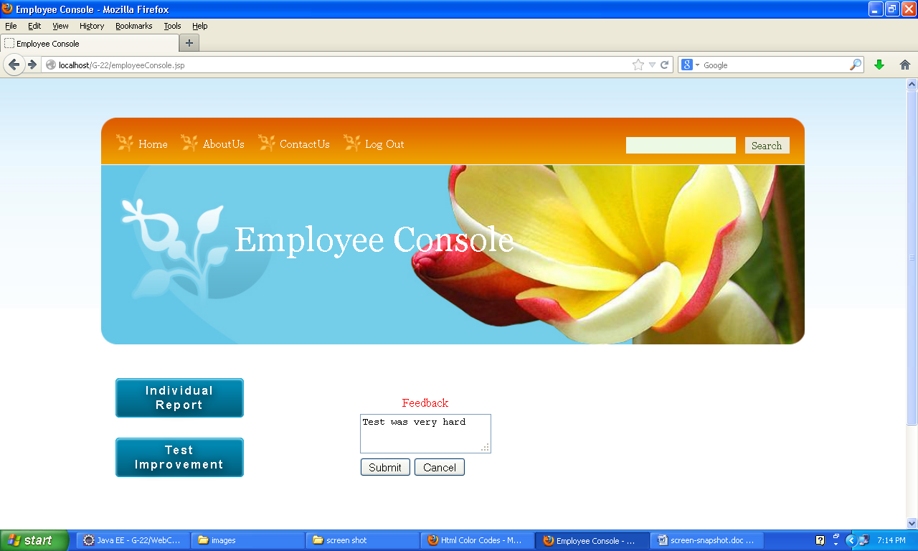

Slide 31
Thank you

